Slide 1


FPT SOFTWARE
Machine Learning Fundamentals
10/02/18

Slide 2
Reinforcement Learning
Lecture 5: Reinforcement Learning
Outline:
Fundamentals of Reinforcement Learning
Markov Decision Processes
Q-Learning
Quizzes
Graduation

Slide 3
Previous Lectures
Fundamentals of Reinforcement Learning
Supervised learning
classification, regression
Unsupervised learning
clustering
Reinforcement learning
more general than supervised/unsupervised learning
learn from interaction w/ environment to achieve a goal
environment
reward
new state
action
agent

Slide 4
Fundamentals of Reinforcement Learning
Examples
Defining an RL problem
Markov Decision Processes
Solving an RL problem
Dynamic Programming
Monte Carlo methods
Temporal-Difference learning

Slide 5
Robot in a room
 |  |  | +1
 |  |  | -1
START
actions: UP, DOWN, LEFT, RIGHT
UP
80% move UP
10% move LEFT
10% move RIGHT
reward +1 at [4,3], -1 at [4,2]
reward -0.04 for each step
what’s the strategy to achieve max reward?
what if the actions were deterministic?
Notes:
want to learn a policy (what’s the solution?)
can we learn it using (un)supervised learning? why not?
so how do we learn it? any ideas?
let the robot explore the environment

Slide 6
Other examples
Pole-balancing
TD-Gammon [Gerry Tesauro]
Helicopter [Andrew Ng]
No teacher who would say “good” or “bad”
is reward “10” good or bad?
rewards could be delayed
Similar to control theory
more general, fewer constraints
Explore the environment and learn from experience
not just blind search, try to be smart about it

Slide 7
Fundamentals of Reinforcement Learning
Examples
Defining an RL problem
Markov Decision Processes
Solving an RL problem
Dynamic Programming
Monte Carlo methods
Temporal-Difference learning

Slide 8
Robot in a room
 |  |  | +1
 |  |  | -1
START
actions: UP, DOWN, LEFT, RIGHT
UP
80% move UP
10% move LEFT
10% move RIGHT
reward +1 at [4,3], -1 at [4,2]
reward -0.04 for each step
states
actions
rewards
what is the solution?
Notes:
want to learn a policy (what’s the solution?)
can we learn it using (un)supervised learning? why not?
so how do we learn it? any ideas?
let the robot explore the environment

Slide 9
Markov Decision Process (MDP)
Set of states S, set of actions A, initial state S₀
Transition model P(s,a,s’)
P( [1,1], up, [1,2] ) = 0.8
Reward function r(s)
r( [4,3] ) = +1
Goal: maximize cumulative reward in the long run
Policy: mapping from S to A
π(s) or π(s,a) (deterministic vs. stochastic)
Reinforcement learning
transitions and rewards usually not available
how to change the policy based on experience
how to explore the environment
environment
reward
new state
action
agent

Slide 10
Computing return from rewards
Episodic (vs. continuing) tasks
“game over” after N steps
optimal policy depends on N; harder to analyze
Additive rewards
V(s₀, s₁, …) = r(s₀) + r(s₁) + r(s₂) + …
infinite value for continuing tasks
Discounted rewards
V(s₀, s₁, …) = r(s₀) + γ*r(s₁) + γ²*r(s₂) + …
value bounded if rewards bounded

Slide 11
Value functions
State value function: V^{π}(s)
expected return when starting in s and following π
State-action value function: Q^{π}(s,a)
expected return when starting in s, performing a, and following π
Useful for finding the optimal policy
can estimate from experience
pick the best action using Q^{π}(s,a)
Bellman equation
s
a
r
s’

Slide 12

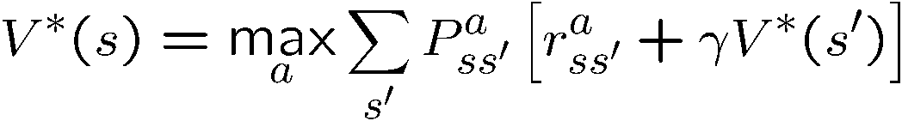

Optimal value functions
There’s a set of optimal policies
V^{π} defines partial ordering on policies
they share the same optimal value function
Bellman optimality equation
system of n non-linear equations
solve for V*(s)
easy to extract the optimal policy
Having Q*(s,a) makes it even simpler
s
a
r
s’

Slide 13
Outline
Examples
Defining an RL problem
Markov Decision Processes
Solving an RL problem
Dynamic Programming
Monte Carlo methods
Temporal-Difference learning

Slide 14
Dynamic programming
Main idea
Use value functions to structure the search for good policies
Need a perfect model of the environment
Two main components
Policy evaluation: compute V^{π} from π
Policy improvement: improve π based on V^{π}
Start with an arbitrary policy
Repeat evaluation/improvement until convergence

Slide 15
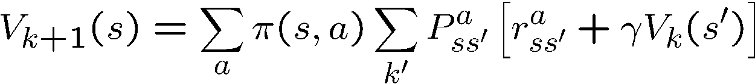

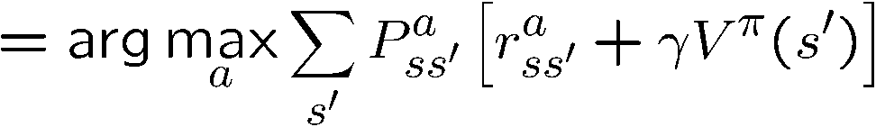
Policy evaluation/improvement
Policy evaluation: π -> V^{π}
Bellman eqn’s define a system of n eqn’s
Could solve, but will use iterative version
Start with an arbitrary value function V₀, iterate until V_{k} converges
Policy improvement: V^{π} -> π’
π’ either strictly better than π, or π’ is optimal (if π = π’)

Slide 16
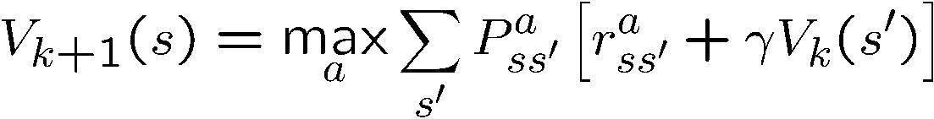
Policy/Value iteration
Policy iteration
Two nested iterations; too slow
Don’t need to converge to V^{πk}
just move towards it
Value iteration
Use Bellman optimality equation as an update
Converges to V*

Slide 17
Using DP
Need complete model of the environment and rewards
Robot in a room
state space, action space, transition model
Can we use DP to solve
Robot in a room?
Back gammon?
Helicopter?

Slide 18
Fundamentals of Reinforcement Learning
Examples
Defining an RL problem
Markov Decision Processes
Solving an RL problem
Dynamic Programming
Monte Carlo methods
Temporal-Difference learning
Miscellaneous
state representation
function approximation
rewards

Slide 19
Monte Carlo methods
Don’t need full knowledge of environment
just experience, or
simulated experience
But similar to DP
policy evaluation, policy improvement
Averaging sample returns
defined only for episodic tasks

Slide 20
Monte Carlo policy evaluation
Want to estimate V^{π}(s)
= expected return starting from s and following π
estimate as average of observed returns in state s
First-visit MC
average returns following the first visit to state s
s
s
s₀
R₁(s) = +2
+1
-2
0
+1
-3
+5
s₀
s₀
R₂(s) = +1
s₀
R₃(s) = -5
s₀
s₀
R₄(s) = +4
V^{π}(s) ≈ (2 + 1 – 5 + 4)/4 = 0.5

Slide 21
Monte Carlo control
V^{π} not enough for policy improvement
need exact model of environment
Estimate Q^{π}(s,a)
MC control
update after each episode
Non-stationary environment
A problem
greedy policy won’t explore all actions

Slide 22
Maintaining exploration
Deterministic/greedy policy won’t explore all actions
don’t know anything about the environment at the beginning
need to try all actions to find the optimal one
Maintain exploration
use soft policies instead: π(s,a)>0 (for all s,a)
ε-greedy policy
with probability 1-ε perform the optimal/greedy action
with probability ε perform a random action
will keep exploring the environment
slowly move it towards greedy policy: ε -> 0

Slide 23
Summary of Monte Carlo
Don’t need model of environment
averaging of sample returns
only for episodic tasks
Learn from sample episodes or simulated experience
Can concentrate on “important” states
don’t need a full sweep
Need to maintain exploration
use soft policies

Slide 24
Fundamentals of Reinforcement Learning
Examples
Defining an RL problem
Markov Decision Processes
Solving an RL problem
Dynamic Programming
Monte Carlo methods
Temporal-Difference learning
Miscellaneous
state representation
function approximation
rewards

Slide 25
Temporal Difference Learning
Combines ideas from MC and DP
like MC: learn directly from experience (don’t need a model)
like DP: learn from values of successors
works for continuous tasks, usually faster than MC
Constant-alpha MC:
have to wait until the end of episode to update
Simplest TD
update after every step, based on the successor
target

Slide 26
MC vs. TD
Observed the following 8 episodes:
A – 0, B – 0 B – 1 B – 1 B - 1
B – 1 B – 1 B – 1 B – 0
MC and TD agree on V(B) = 3/4
MC: V(A) = 0
converges to values that minimize the error on training data
TD: V(A) = 3/4
converges to ML estimate of the Markov process
r = 1
75%
r = 0
100%
A
B
r = 0
25%

Slide 27
The RL Intro book
Richard Sutton, Andrew Barto
Reinforcement Learning, An Introduction
http://www.cs.ualberta.ca/ ~sutton/book/the-book.html

Slide 28
Q-learning
Before: on-policy algorithms
start with a random policy, iteratively improve
converge to optimal
Q-learning: off-policy
use any policy to estimate Q
Q directly approximates Q* (Bellman optimality eqn)
independent of the policy being followed
only requirement: keep updating each (s,a) pair

Slide 29
Fundamentals of Reinforcement Learning
Examples
Defining an RL problem
Markov Decision Processes
Solving an RL problem
Dynamic Programming
Monte Carlo methods
Temporal-Difference learning
Miscellaneous
State representation
Function approximation
Rewards

Slide 30
State representation
Pole-balancing
move car left/right to keep the pole balanced
State representation
position and velocity of car
angle and angular velocity of pole
What about Markov property?
would need more info
noise in sensors, temperature, bending of pole
Solution
coarse discretization of 4 state variables
left, center, right
totally non-Markov, but still works

Slide 31
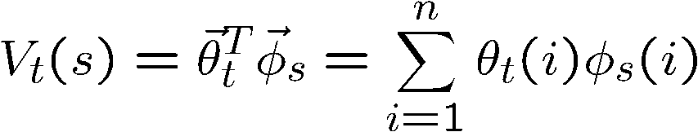
Function approximation
Represent V_{t} as a parameterized function
linear regression, decision tree, neural net, …
linear regression:
Update parameters instead of entries in a table
better generalization
fewer parameters and updates affect “similar” states as well
TD update
treat as one data point for regression
want method that can learn on-line (update after each step)

Slide 32
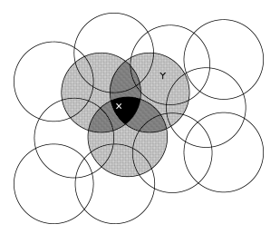
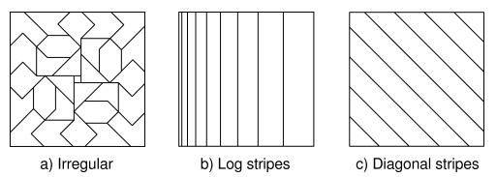
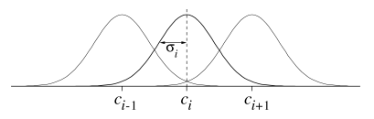
Features
Tile coding, coarse coding
binary features
Radial basis functions
typically a Gaussian
between 0 and 1
[ Sutton & Barto, Reinforcement Learning ]

Slide 33
Splitting and aggregation
Want to discretize the state space
learn the best discretization during training
Splitting of state space
start with a single state
split a state when different parts of that state have different values
State aggregation
start with many states
merge states with similar values

Slide 34
Designing rewards
Robot in a maze
episodic task, not discounted, +1 when out, 0 for each step
Chess
GOOD: +1 for winning, -1 losing
BAD: +0.25 for taking opponent’s pieces
high reward even when lose
Rewards
rewards indicate what we want to accomplish
NOT how we want to accomplish it
Shaping
positive reward often very “far away”
rewards for achieving subgoals (domain knowledge)
also: adjust initial policy or initial value function
Notes:
maybe show the pendulum?

Slide 35
Summary
Reinforcement learning
use when need to make decisions in uncertain environment
Solution methods
Dynamic programming
need complete model
Monte Carlo
Time-difference learning (Sarsa, Q-learning)
Most work
Algorithms simple
Need to design features, state representation, rewards

